Slide 1

Curves of the Second Order in Plane
Definition: Locus of the points with coordinates satisfying the general equation of the second degree is the curve of the second order. At the same time the equation
The second order curves are, for example, circle, ellipse, hyperbola, parabola, pair of straight lines, etc.

Slide 2
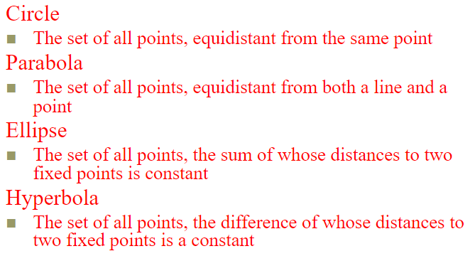
Definition

Slide 3
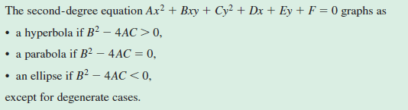
Discriminant Test
www.desmos.com/calculator

Slide 4
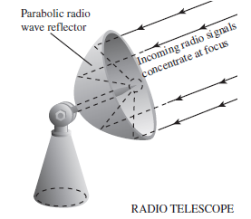
Parabola

Slide 5
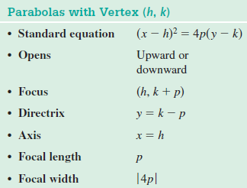
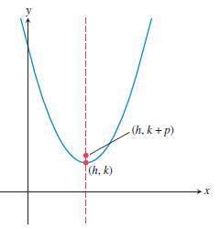
Parabola

Slide 6

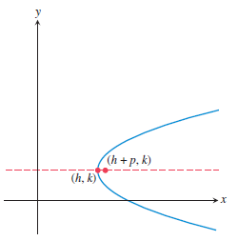
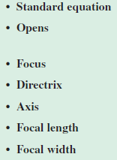
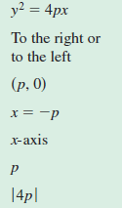
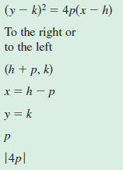
Parabola

Slide 7


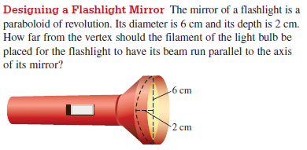
Practice 1
Find an equation in standard form for the parabola that satisfies the given conditions.
prove that the graph of the equation is a parabola, and find its vertex, focus, and directrix.

Slide 8
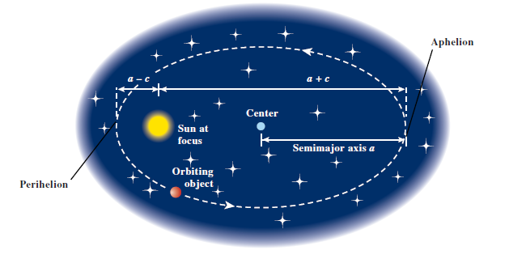
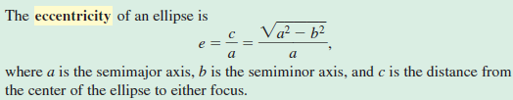
Ellipse

Slide 9
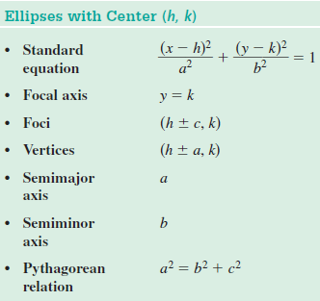
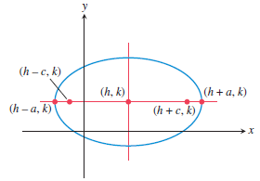
Ellipse

Slide 10

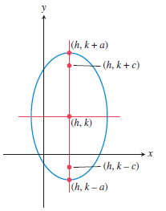
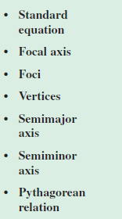
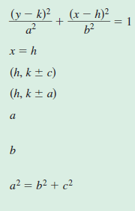
Ellipse

Slide 11


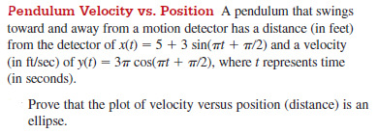
Practice 2
sketch the graph of the ellipse by hand
find an equation in standard form for the ellipse that satisfies the given conditions.

Slide 12
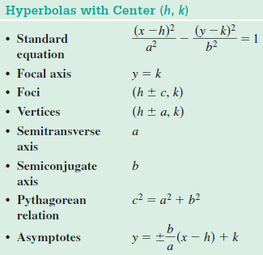
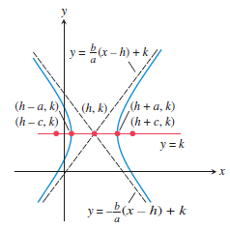
Hyperbola

Slide 13
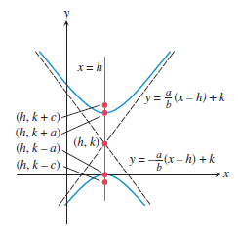
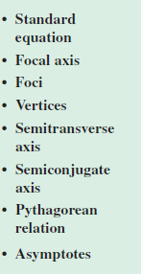
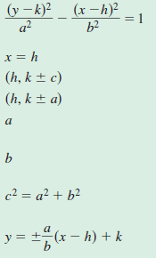
Hyperbola

Slide 14

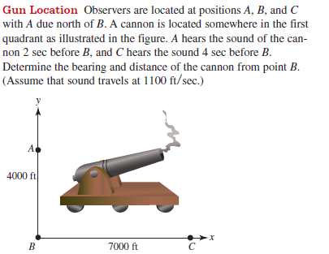
Practice 3
find an equation in standard form for the hyperbola that satisfies the given conditions.

